Slide 1

Nasdaq trends
Presented by:
Niecole Casciani and Vasin Chee

Slide 2
introductions

Slide 3
Niecole casciani
PREVIOUS EDUCATION:
Studied at UCR for 2 ½ years with a major in Biology
B.A. in Psychology from Argosy University in 2008
PREVIOUS CAREERS:
Substitute teacher for grades K-12th grade
Youth Pastor for 8 years
CURRENTLY SELF-EMPLOYED:
As an Operations Manager, 10 years
Coordinate military charters with commercial airlines that operate in and out of March AFB in Riverside, CA

Slide 4
Vasin chee
Previous Education
Some years of college
Previous Career
Metro Bus Operator
Current Employment
Full Time Stock Trader

Slide 5
Topic introduction

Slide 6
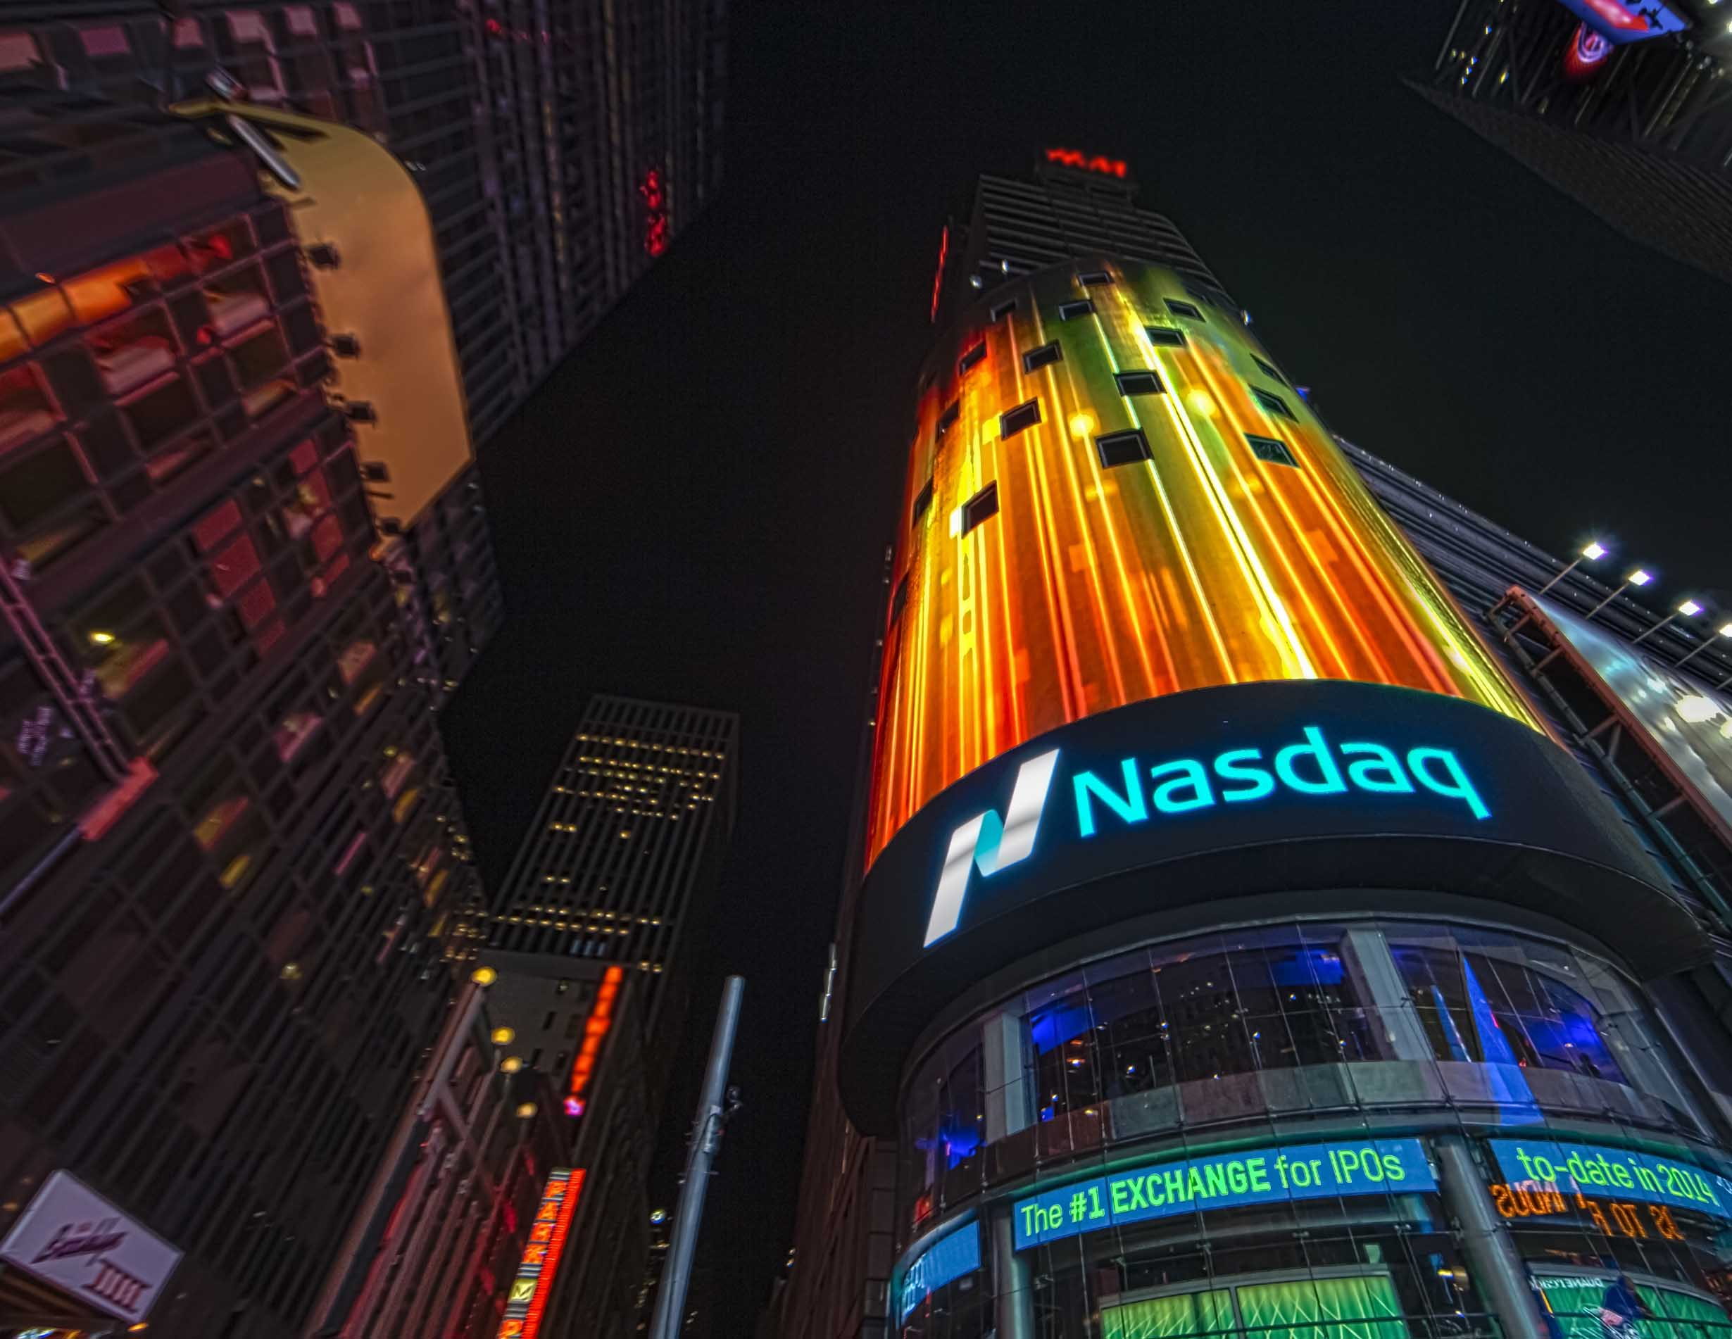
What is Nasdaq?
American stock exchange, ranked second behind the New York Stock Exchange
NASDAQ= National Association of Securities Dealers Automated Quotations exchange
It became the world’s first electronic stock market in 1971 where investors could buy and sell stock without physically being on a trading floor
The Nadaq contains all of the companies that trade on the Nasdaq
Most of the companies are technology and internet related, but there are financial, consumer, biotech and industrial companies as well.
The Nasdaq tracks more than 3300 stocks and has around 1000 listed companies with a market capitalization of at least 1 billion in USD

Slide 7
Nasdaq composite
* Benchmark index of the Nasdaq
* It includes almost all stocks listed on the Nasdaq stock market
* Due to it’s tech-heavy stock index, the Nasdaq Composite is an efficient way to measure the performance of the tech market
*This index is calculated constantly throughout the trading day with the final value reported at 4:16pm daily once the prices have fully settled after the 4pm ET market close
*It is a capitalization weighted index
*When larger companies’ stocks move, it has a greater effect on the performance of the index than when the stocks of smaller companies move

Slide 8
Nasdaq composite Composition
As of March 2020:
48.39% Tech companies
19.43% Consumer services
10.21% Health Care
7.21% Financials
6.85% Industrials
5.51% Consumer goods
0.81% Utilities
0.72% Telecommunications
0.55 % Oil and gas
0.32% Basis materials

Slide 9
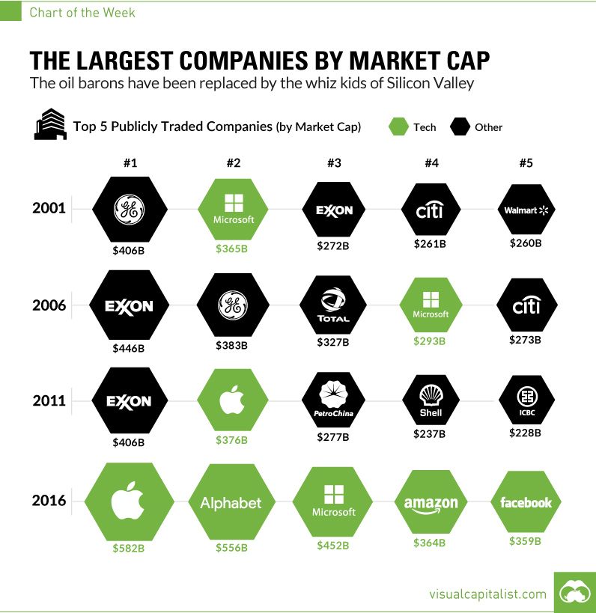
History of TOP Companies

Slide 10

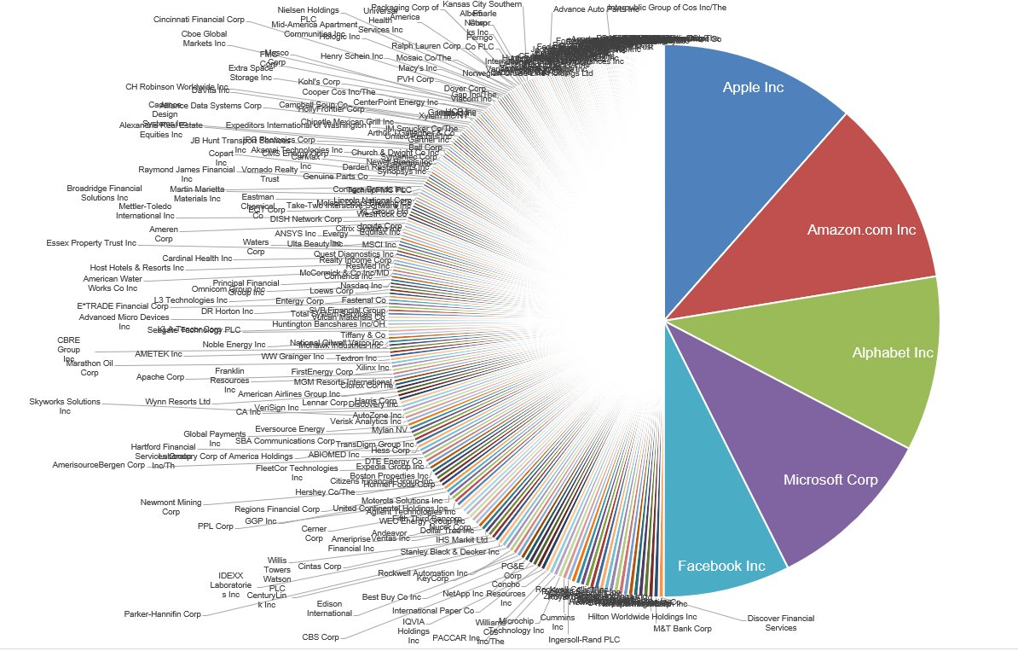
Nasdaq composite
The top 10 stocks in the Nasdaq composite account for one third of the index’s performance
The top 10 include:
-Microsoft (MSFT)
-Apple(AAPL)
-Alphabet class C (Google)
-Alphabet class A (Google)
-Facebook(FB)
-Intel(INTC)
-Netflix(NFLX)
-PepsiCo(PEP)
-CiscoSystems(CSCO)

Slide 11
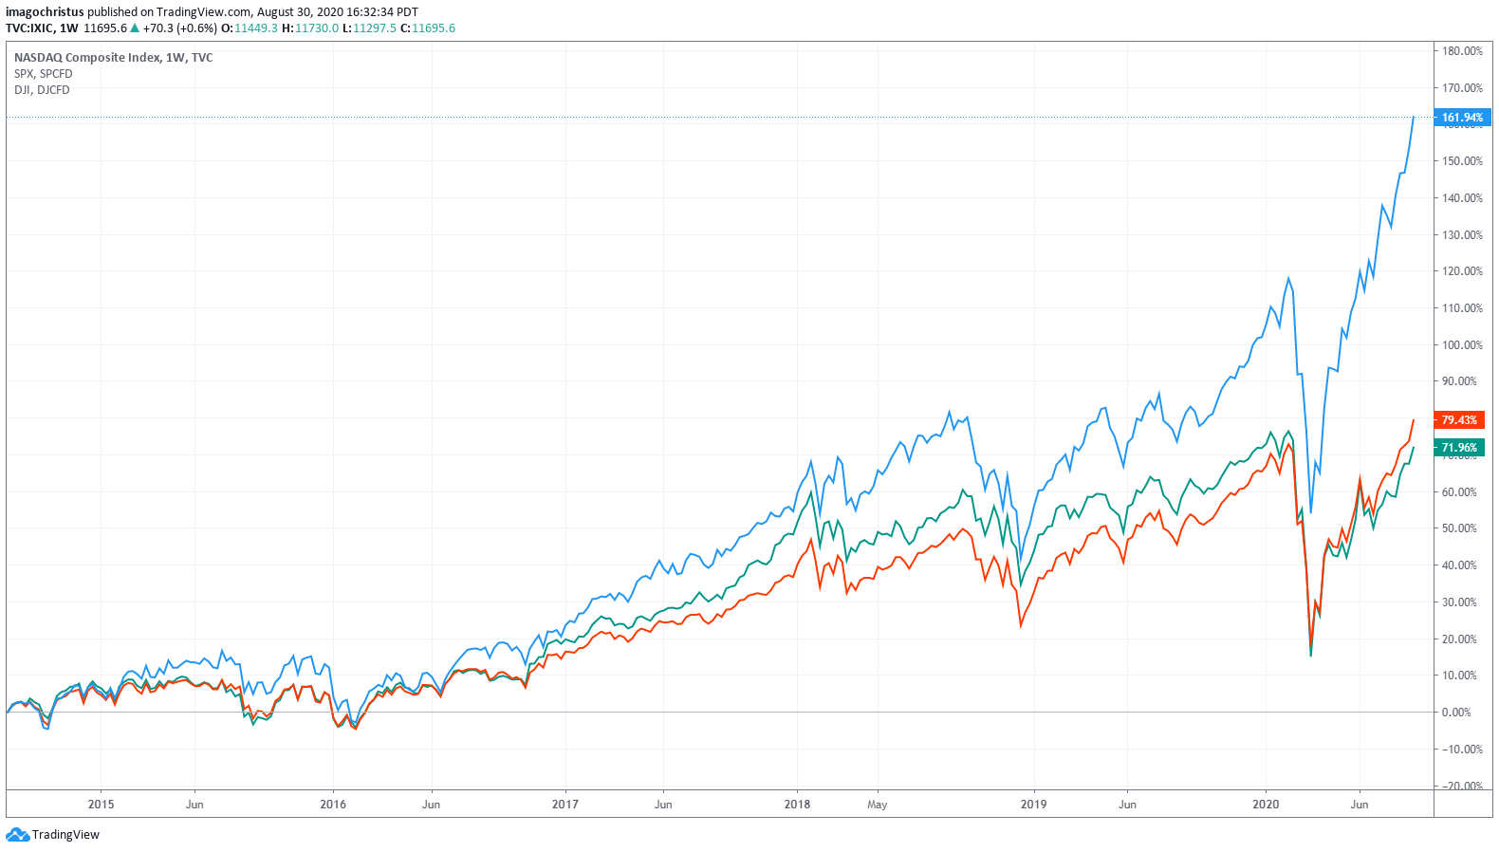
Indices Comparison

Slide 12
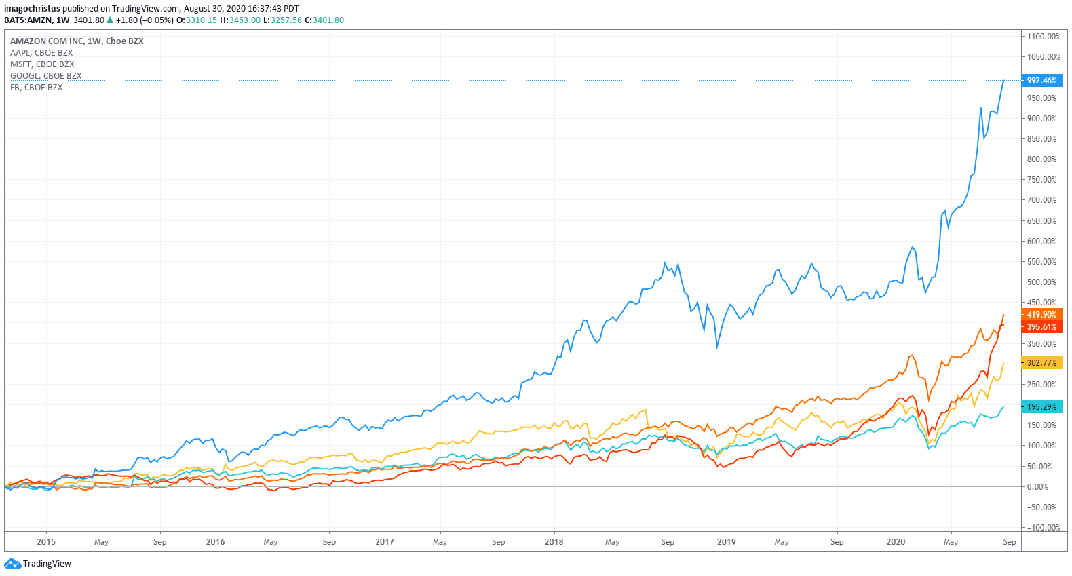
Top Companies Side by SIde

Slide 13

Our dataset:
End-of-day Data of 8000+ stocks trading on AMEX, NYSE and NASDAQ
https://www.kaggle.com/qks1lver/amex-nyse-nasdaq-stock-histories
CSV file tracking stocks from the
past 5 years.

Slide 14
Wrangling our data
Original Dataset:
1,048,575 rows and 8 columns
Used the R programming language to wrangle our dataset
Then decided to subset our data to include 3 variables out of 8
Filtered the dataset to only include the top 5 companies of the Nasdaq composite
Our final dataset had 3 variables and 2,770 rows

Slide 15
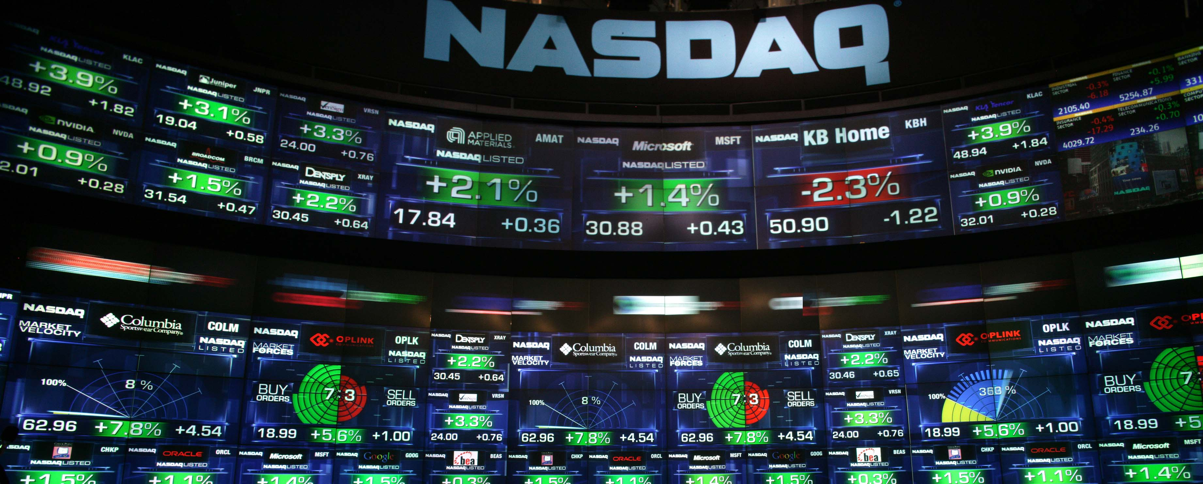
Variables for analysis
The 3 variables we chose to run a linear regression on through R were Date( included every business day for the past 5 years) and Close (Closing price of stock that day)
We set the Close variable as our Dependent variable and Date as our Independent variable
Our analysis did not show a significant correlation between closing price and time
However, we did find interesting trends through our charts using Tableau
If we had more time, we could have explored the effect of creating a lead or lag variable into our dataset
This may have helped to analyze the direction of the closing stock prices

Slide 16
Summary
Right now, the most paid for and sought-after information in the world is stock market data. There are trillions of dollars lined up and ready to trade at any given moment. The money must be divided according to what is most useful to people in charge of it. In our project, we would like to propose the Nasdaq is a great long-term investment that tends to beat out the broader markets. It contains many companies with cutting edge technology that utilize it for greatest profit and the betterment of society. From fintech to biotech. These companies are changing the world and can grow our pockets.

Slide 17
Conclusion
Nasdaq Composite Index is a good long-term investment.
It contains the worlds best companies constantly outperforming the rest of the broader market.
In past 5 years you could have let your money sit in a savings account and lose about 2% a year due to inflation or gain 200% from investing in in the Nasdaq.
Market cycles are important to consider before investing and the best time is after a crash like the dot com bubble or housing crash of 2009.

Slide 18

Questions?

